Slide 1

Smart Home
By :
Ahmed Ashraf Mohammed
Mohamed Aboelela
Karim Al Telbany
Osama Ismaeel

Slide 2



Agenda
Introduction
Components Required
Design
Specification

Slide 3


Introduction
A smart home refers to a convenient home setup where appliances and devices can be automatically controlled remotely from anywhere with an internet connection using a mobile or other networked device. Devices in a smart home are interconnected through a controller, allowing the user to control functions such as security access to the home, temperature, lighting, and a home theater remotely.

Slide 4

Components Required
Atmega-32
Buttons
Alarm (Buzzer)
Keypad
LEDS
LCD (lm016L)
Temperature Sensor (lm35)
Motors(Servo –DC)
Bluetooth Module (HC05)
Oscilloscope
Potentiometer
Lamp Dimmer
EEPROM (M24C16)

Slide 5
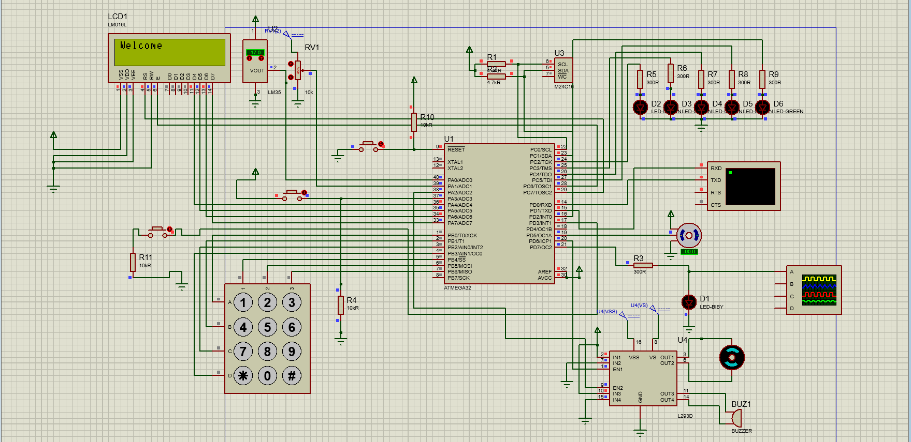
Schematic Design using proteus

Slide 6
Specifications
Walt Disney
Security
Temperature Controller
Light System

Slide 7

Security

Slide 8
With Two Login Mode (Admin & User)
Admin Mode Can connect To the System Using Mobile Application, it has the Ability to :
Open the Door
Add User or Remove him
Change his password
Users can connect by the Keypad , their features Limited on Control the light
Login System has 3 Trails or fire alarm will go up and system will stop till reset button is pressed
Foe more security in the signup the new password is entered twice to make sure that no mistake with admin eatery

Slide 9

Temperature Control

Slide 10
Ac System Opened from starting of the system and control by a sensor :
if the temperature is higher than 28 °C, Air condition run, if the temperature becomes lower than 21 °C, Air condition turned off

Slide 11

Light System

Slide 12
Light Control In user Mode By the Keybad T hey are noumbred And by press the correct butoon the light is turned on or off
Same in the admin mode but remotely By mobile app.

Slide 13
The LCD Used to interface with The user tom make it easier to interact with the system
While messages sent to admin to interact with the system with buttons added to the mobile app.

Slide 14

Summary
Installing a smart home technology system provides homeowners with convenience. Rather than controlling appliances, thermostats, lighting, and other features using different devices, homeowners can control them all using one device—usually a smartphone or tablet.

Slide 15


Thank You

